Slide 1
Dessert Shops exploration in Toronto, Canada

Slide 2
Introduction
To help the companies and entrepreneurs that planning to expand their business, open new shops or franchise in Toronto, Canada.
Main problem – Best location for new shops, franchise, number of competitors ?
- What best shops at certain location ?
Target audience – companies, entrepreneurs, people who interested to explore the shops

Slide 3
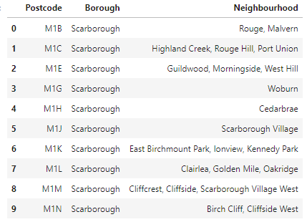
Data
https://en.wikipedia.org/wiki/List_of_postal_codes_of_Canada:_M

Slide 4
Methodology
Exploratory Data Analysis
Data Cleaning
Data Modification
Machine Learning

Slide 5
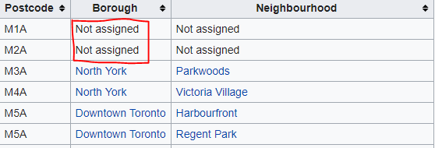

Data Cleaning

Slide 6
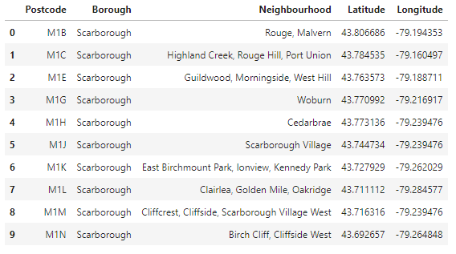
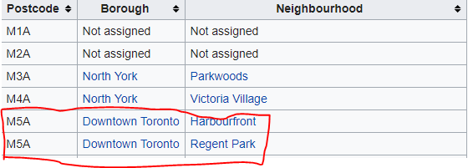
Data Modification

Slide 7
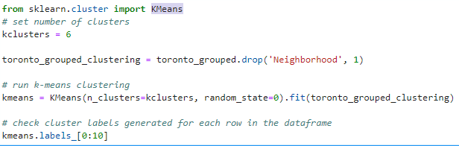
Machine Learning

Slide 8
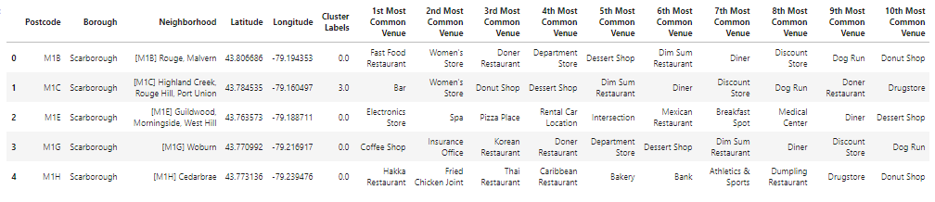
Result and Discussion

Slide 9
Conclusion

